Slide 1

Population Growth Control Scheme
By Team Invincible Boys

Slide 2
Explosive population growth is a critical concern in developing countries like India. Excessive population can lead to many adverse effects like unplanned construction, overwhelming pressure on the resources of a region, deforestation, droughts, rise in poverty, etc.
In this presentation we shall address the issues and provide a 10 year road map for the GOI to curb the excessive population growth.
Proposed Solutions
Education and Awareness
Easily accessible Contraceptives
Skill Development and Job Creation
Better Healthcare
Incentives for Small Families
Monitoring & Evaluation

Slide 3
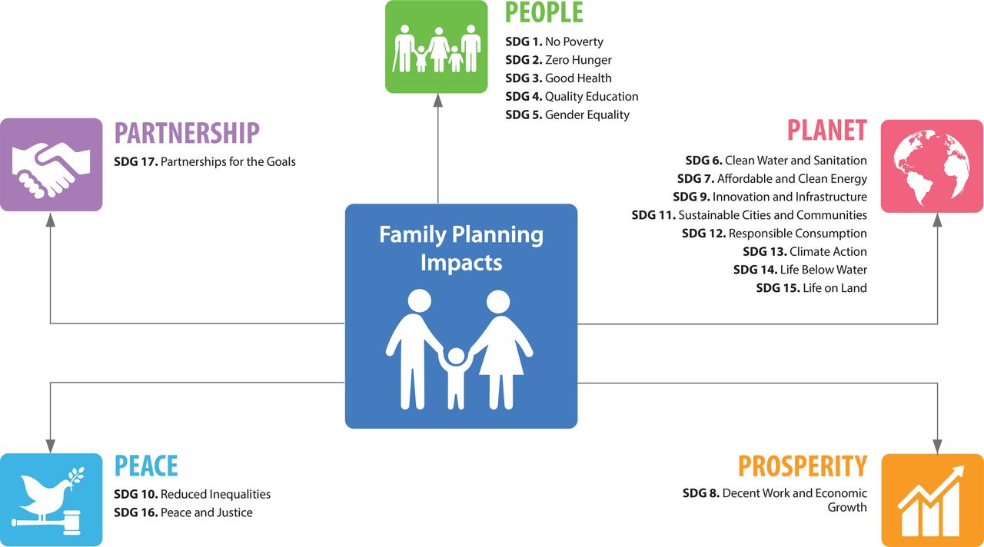

Education and Awareness
Promotion of education and awareness is one of the most effective ways to control population growth. The government should launch a comprehensive national campaign to educate people about the benefits of family planning, the importance of having small families, and the negative economic and environmental consequences of overpopulation. This campaign should also be implemented in rural areas, which are home to the majority of the population. Technology should be used to promote effective family planning and awareness campaigns on social media platforms.

Slide 4



Easily Accessible Contraceptives
Contraception should be made easily accessible to all citizens by the government. It should ensure that there is an adequate supply of contraceptives at reasonable prices, and that these are accessible even in the most remote areas. This can be accomplished by establishing more family planning clinics that are well-equipped and adequately staffed.

Slide 5


Skill Development & Job Creation
As a means of addressing unemployment, the government should prioritise skill development and job creation. Unemployment is a key contributor to overpopulation, as unemployed and underemployed individuals tend to have more children. The government should endeavor to create more employment possibilities for the country's youth, which will aid in curbing population increase.

Slide 6

Better Healthcare
It is imperative that the government make investments in order to raise the standard of care provided by medical facilities, in particular in rural areas. The rates of child and maternal mortality, which are also a component that contributes to population growth, will be decreased as a result of this action, which will assist curb the growth of the world's population.

Slide 7

Incentives for Smaller Families
In order to encourage families to have one or two children maximum, the government ought to provide financial incentives. These incentives can take the form of tax reductions, financial aid for further education, or better medical coverage.

Slide 8
Monitoring and Evaluation
The government should regularly monitor and evaluate the effectiveness of its population control measures. This will help in identifying areas that require improvement and making necessary changes to the policies.

Slide 9
In conclusion, a multi-pronged strategy is required in order to effectively address the problem of overpopulation. A time-phased approach to population control should be taken by the government of India, which should adopt a combination of the measures that have been stated above. If the government takes these steps, it will be able to ensure that India's population expansion is both sustainable and compatible with the economic and environmental objectives of the country.
Thank You

